Slide 1
METRIC MASS

Slide 2
The unit used to weigh objects in the Metric System is based on the kilogram.
a. The tool used to measure mass is the balance scale
b. The most commonly used units are the kilogram, the gram, and the milligram

Slide 3
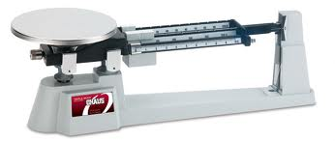
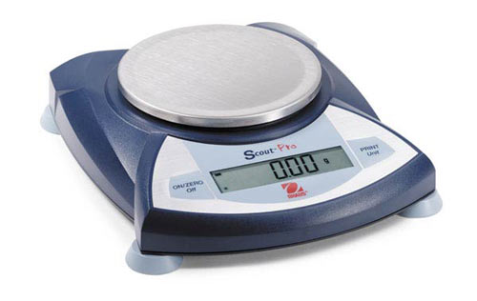

Slide 4
i. 1 gram (g) = 1000 milligrams (mg)
ii. 1 kilogram (kg) = 1000 grams (g)
iii. How many mg are in a kg?

Slide 5
II. References for a gram
a. A gram can be equal to a:
i. Pen cap on a plastic Bic pen
ii. Raisin
iii. Single Smartie candy
iv. Paperclip
b. A brand new US nickel will have a mass of 5 grams

Slide 6
III. Scientific Notation
a. Used to save space when dealing with extremely large or extremely small numbers

Slide 7
Scientific Notation
b. Rules for writing in Scientific Notation
i. must be 1 digit left of the decimal
ii. Move decimal right = 10x –
iii. Move decimal left = 10x +

Slide 8
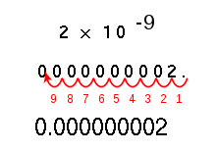
Scientific Notation

Slide 9
Example
A tennis shoe has a mass of 963 grams. In milligrams, it is 963,000 mg, so in scientific notation we would write it as:
9.63 x 10⁵ mg

Slide 10
Using the same shoe, how many kilograms does it weigh?
.963 kg
In scientific notation, it would be written: 9.63 x 10⁻¹ kg

