Slide 1
Deoxyribonucleic Acid

Slide 2
Goals
Who helped discover DNA?
What does DNA look like?
What is DNA made of?
What is the job of DNA?
Where does DNA come from?

Slide 3
Chargaff
Who:
What:
When:
Where
How:
Erwin Chargaff
Discovered amounts of
Adenine = Thymine
Guanine = Cytosine
1950’s
Columbia University, New York
Isolated the bases and measured their amounts with chromatography

Slide 4
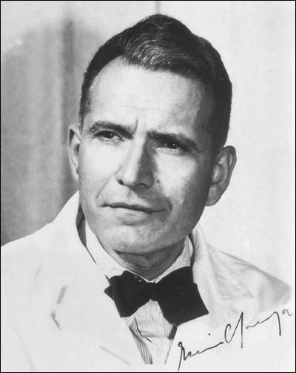
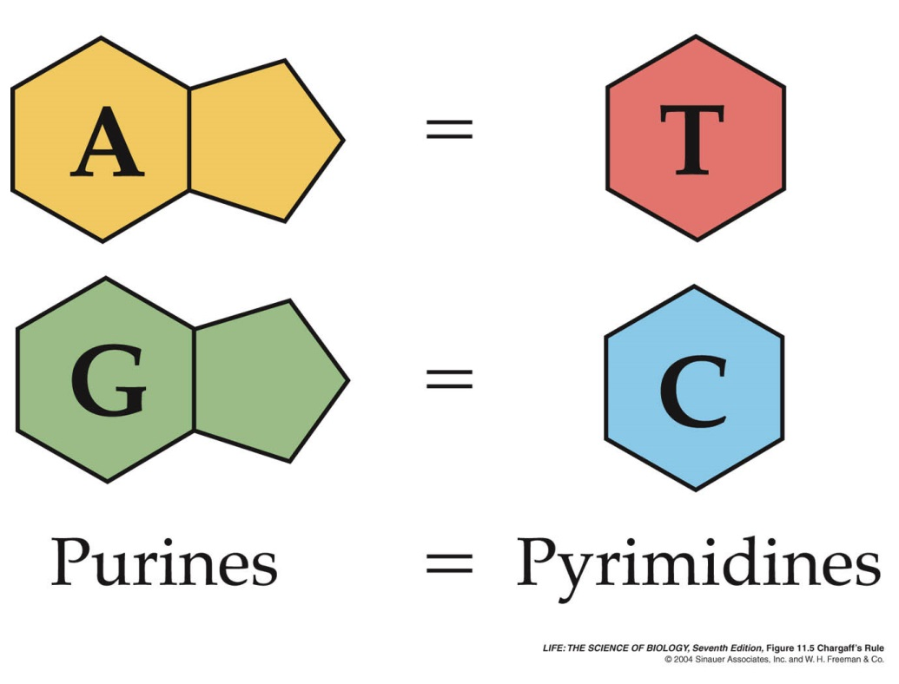
Chargaff

Slide 5
Franklin
Who:
What:
When:
Where
How:
Rosalind Franklin
Took 1st photo of DNA double helix shape
1951
King’s College, London, England
Used x-ray diffraction

Slide 6
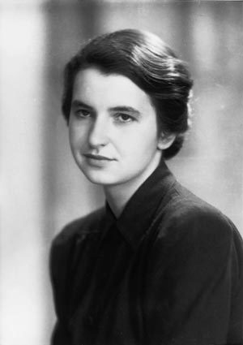
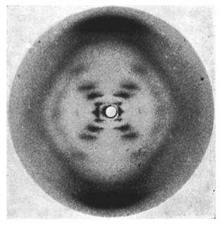
Photo 51

Slide 7
Watson & Crick
Who:
What:
When:
Where
How:
James Watson & Francis Crick
Constructed the first physical model of Deoxyribonucleic Acid (DNA) structure and double helix
1953
Cambridge University, Cambridge, England
Borrowed the information from Chargaff, Franklin, and other scientists

Slide 8
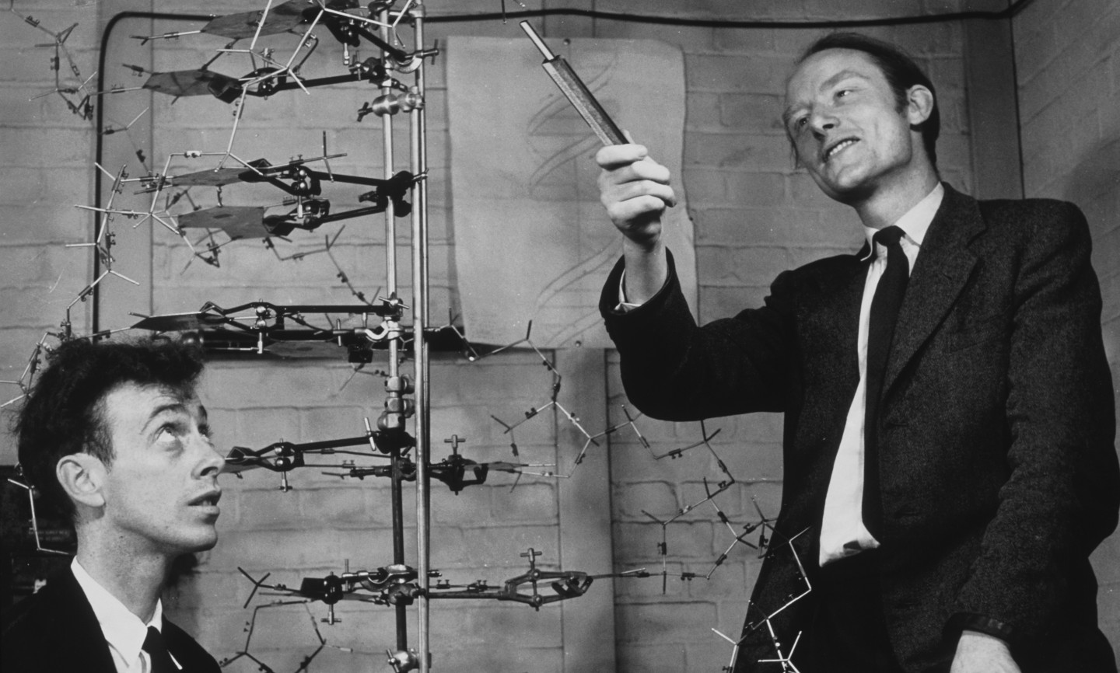
Watson & Crick

Slide 9
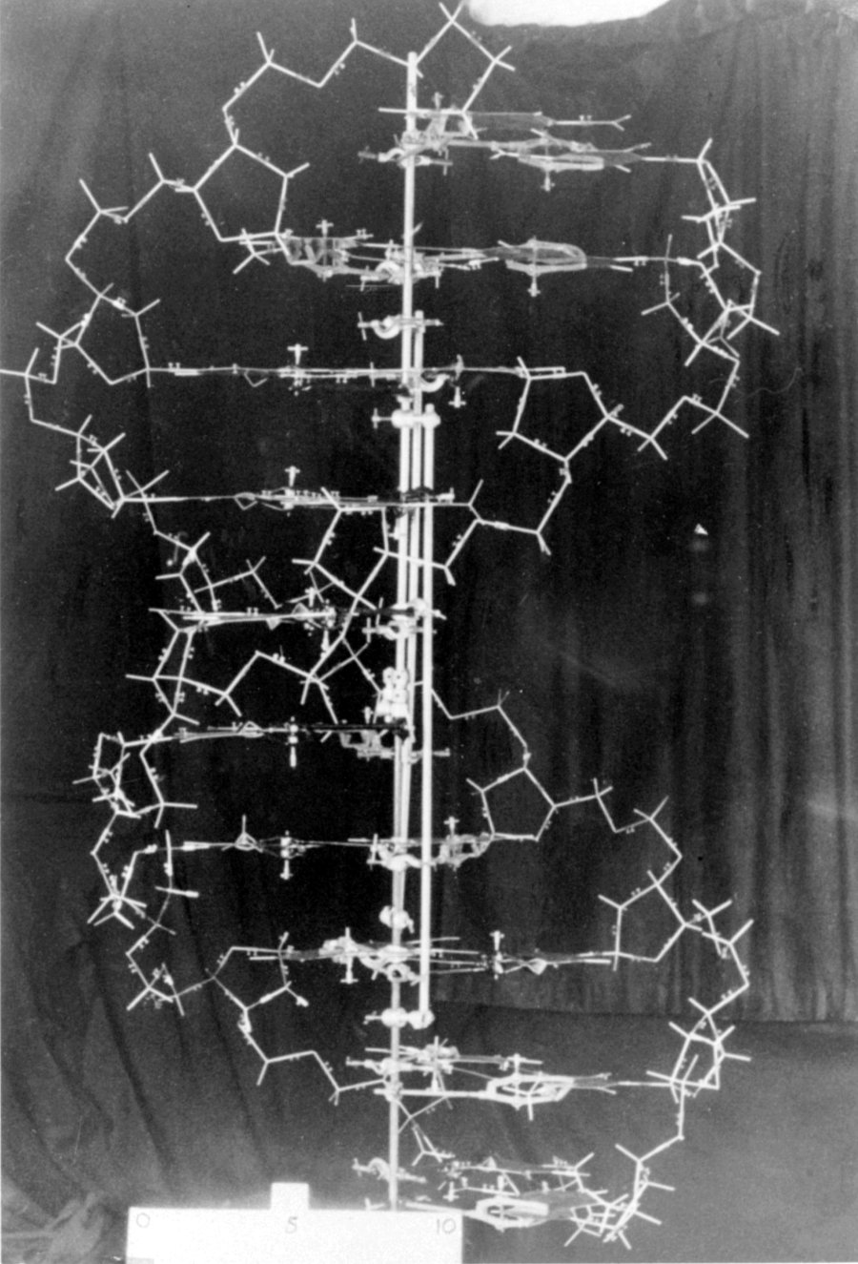

Slide 10
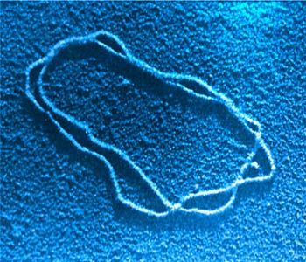
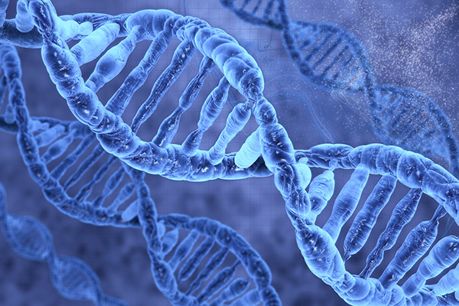
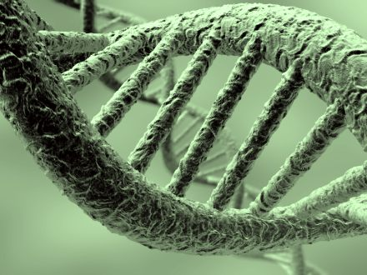
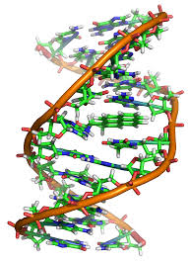
Appearance

Slide 11
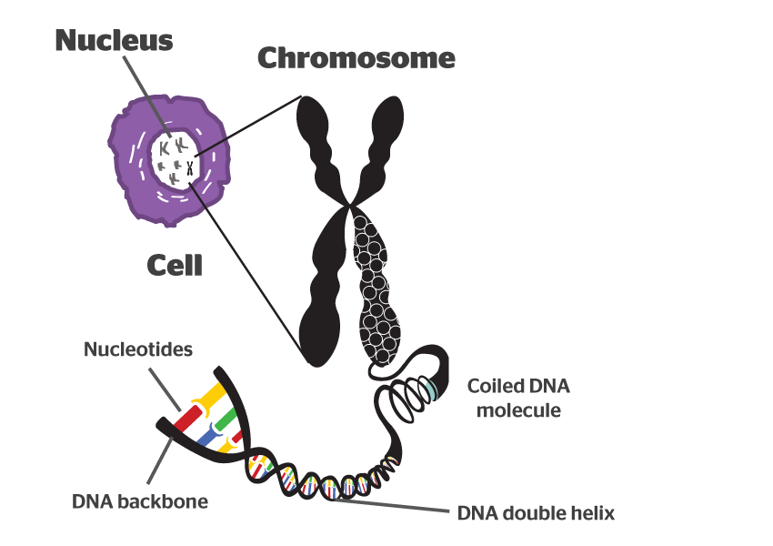
Chromosomes

Slide 12
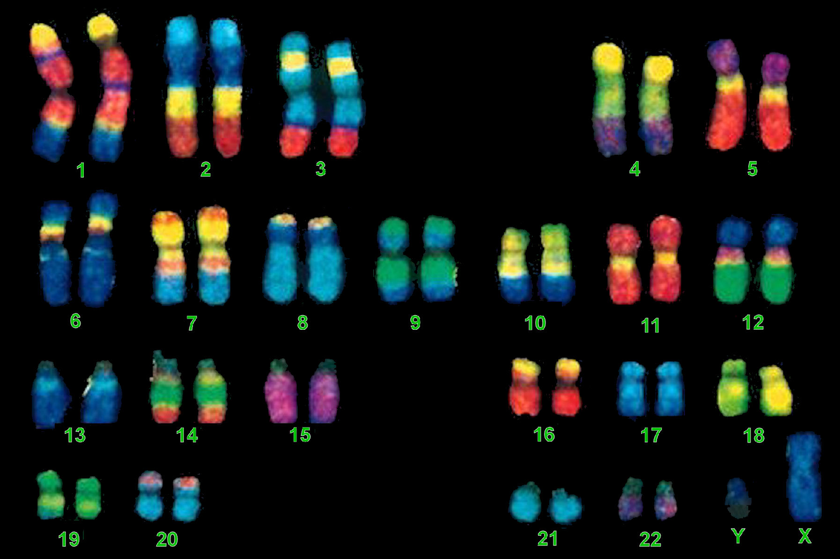
Chromosomes

Slide 13
Your Job
Using chromebooks or textbooks
With your table as your partner(s) answer the following. The oldest person is the designated writer.
1. What is a nucleotide?
2. How many parts are in a nucleotide?
3. What are those parts called?
4. One of those parts can change, list the 4 names for that part.

Slide 14
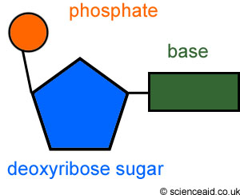
Structure
DNA is made up of small pieces called Nucleotides

Slide 15
Nucleotide Structure (Quiz fill in the blank)
3 parts
Phosphate
Sugar
Nitrogen Base

Slide 16
Nucleotide Structure
The sugar is deoxyribose
ose = sugar
Nitrogen Bases
Adenine
Thymine
Guanine
Cytosine
A = T
C = G

Slide 17
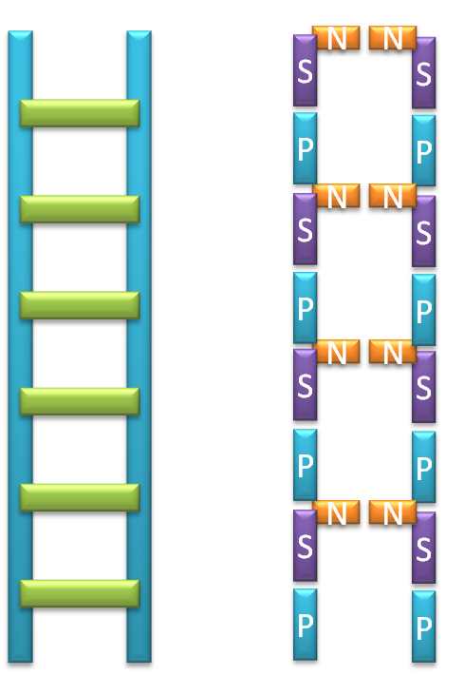
DNA Structure
DNA is like a ladder that has been twisted
Phosphate and sugar alternate up the sides
Bases pair to form the rungs or steps

Slide 18
Function (Job) and Where it comes from (Replication)
Job
To carry genetic information
Contains all of your genotypic information
As a result it gives you your…………..
Replication
Like living things, DNA comes from other DNA
Special process used to copy the information
Happens during Mitosis (which phase/subphase?)
Notes:
Occurs during Interphase S

Slide 19
Semi-Conservative Replication
This is how new DNA is made
1. The original strand is separated
2. Bases are added to make new segments
3. The new segments are glued together to form complete strands
4. Each new strand has half old DNA and half new DNA

Slide 20
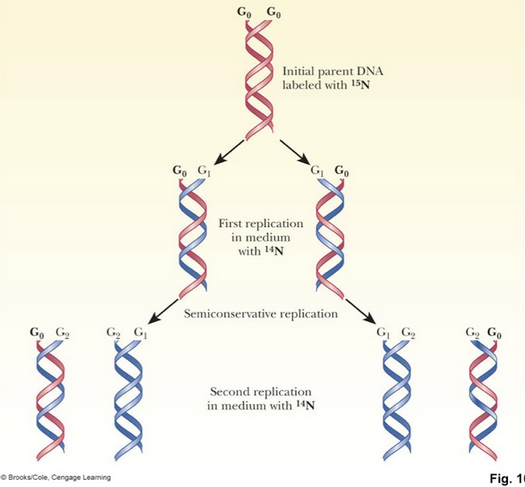

Slide 21
Replication Animation
http://highered.mheducation.com/sites/0072943696/student_view0/chapter3/animation__dna_replication__quiz_1_.html

Slide 22
The DNA Replication Steps (quiz matching)
DNA Helicase unzips the DNA strands
Single strand binding proteins keep the strands apart
RNA Primase lays down a primer
DNA Polymerase adds new nucleotides
Leading strand nucleotides added continuously
Lagging strand nucleotides added in fragments
DNA Ligase glues together the fragments

Slide 23
Quiz Stuff
Scientists – Who/What/When/Where
Nucleotides –
1. What is a nucleotide?
2. How many parts are in a nucleotide?
3. What are those parts called?
4. One of those parts can change, list the 4 names for that part.
Replication steps

Slide 24
Semi-Conservative Replication
This how new __________ is made
1. The original strand is ___________
2. _________ are added to make new ______________
3. The new __________ are __________ together to form complete ________
4. Each new strand has ______________ DNA and _________________ DNA

Slide 25
The DNA Replication Steps
_______________ unzips the DNA strands
_______________keep the strands apart
______________________ lays down a primer
__________________ adds new nucleotides
__________________ nucleotides added continuously
__________________ nucleotides added in fragments
_________________ glues together the fragments

