Slide 1
METRIC VOLUME

Slide 2
I. Metric volume is based off the liter for liquids, or cubic meters for solids
a. 1 mL = 1 cm³
b. 1 L = 0.001 cubic meters
c. 1 kiloliter = 1 m³

Slide 3
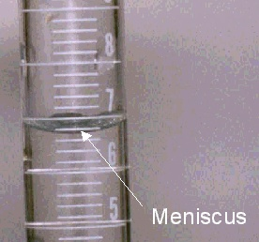
II. Reading Volume
a. Liquids will form a meniscus while in a graduated cylinder.
b. The volume is measured from the bottom of the meniscus

Slide 4
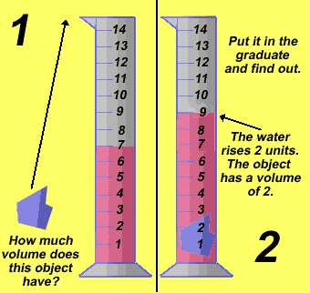
Volume Displacement
a. a solid object will displace an amount of water equal to its volume

Slide 5
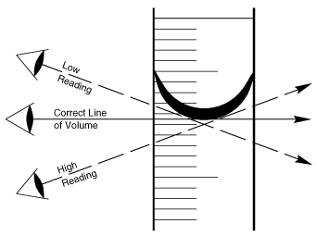
Which eye level will give the most accurate reading?

Slide 6
How much liquid is in this cylinder?

Slide 7
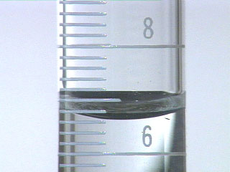
How many mL are in this graduated cylinder?

